Slide 1
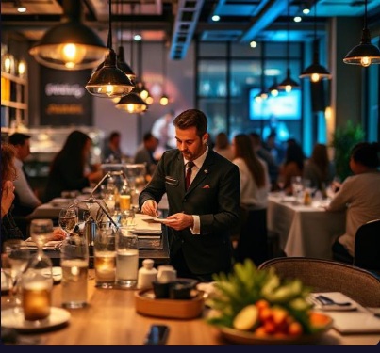
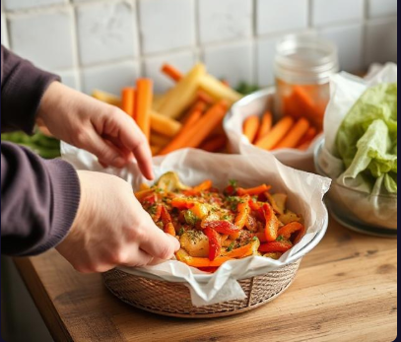
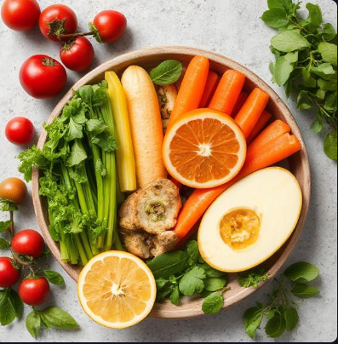
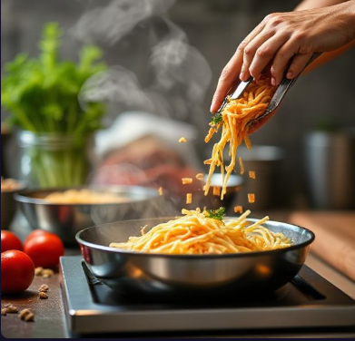
ARTIFICIAL
INTELLIGENCE
CAPSTONE PROJECT
Jagdish Hembrom

Slide 2







Connecting to our Learnings…..
Artificial Intelligence : Real world Applications & Implications
Design Thinking for Innovation
Headache of restaurant owners, chefs, customers
01
06
Used in brain storming, designing user interface
Data Mining
05
CAPSTONE PROJECT
02
Python Programming
Used python for all four modules
Mathematics & Artificial Intelligence - I
04
03
Uses linear algebra in calories conscious game
Generative A.I
Generates recopies considering user requirements

Slide 3


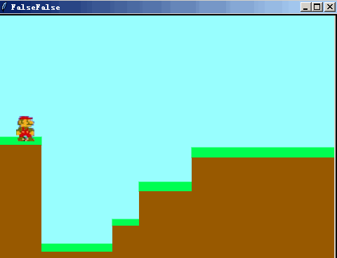

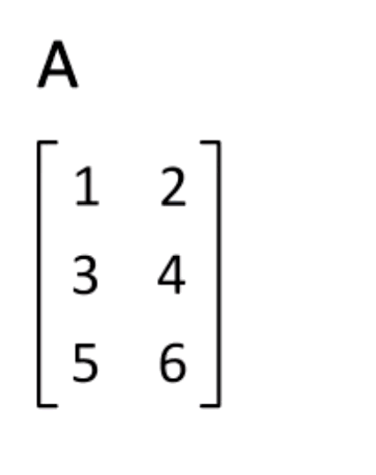


Application of knowledge & skills gained to solve real-world problems.
Our FutureEats app caterers needs of future public, restaurants
Our FutureEats app uses Python coding for all four modules
Our FutureEats app generates recipes as per requirement
e
Our FutureEats app
uses linear algebra for calorie game
Design thinking for Innovation
Is used For
Generative recipes,

Slide 4
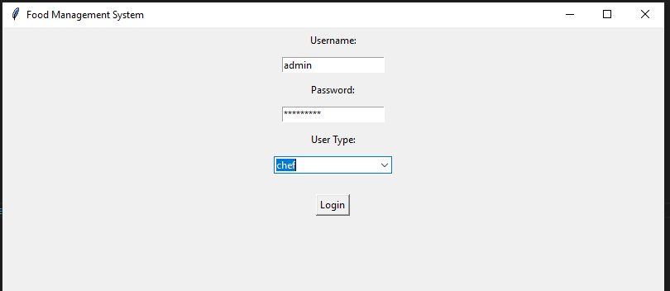
“Smart Restaurant App: FutureEats”
Secure Access to
Personalized Dining Experiences

Slide 5
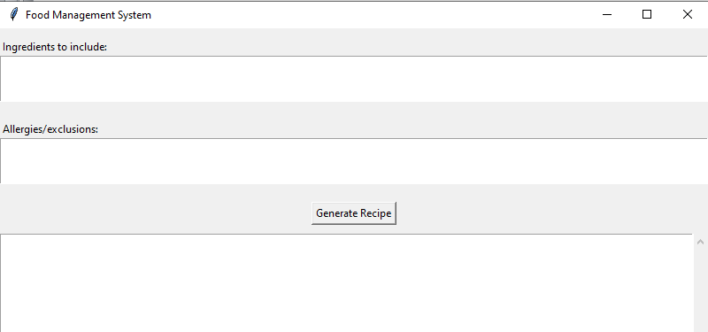
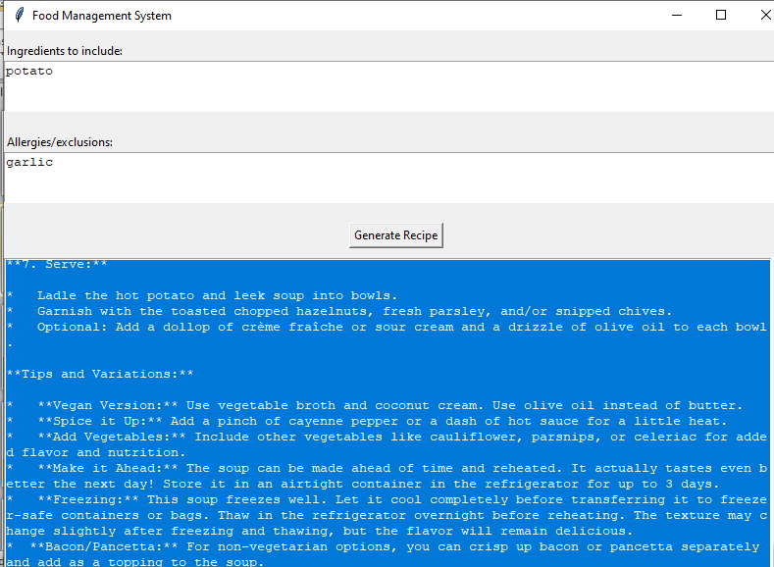
AI-Generated Recipe Suggestions for Chefs
Kitchen Problems Chefs work hard. They must make new, tasty meals. But also avoid wasting food.
Use These Now: Need to cook with potatoes and avocado quickly.
Customer Needs: People want healthy food (like vegan). Some follow religious diets (Jain, halal).
Foods to Avoid: No nuts, gluten, dairy, shellfish, onion, or garlic.
Helpful Solution: Make recipes that fit all needs. Click: "Generate Recipe".
Personalized Dining Experience:

Slide 6
AI generated Recipe
class ChefFrame(tk.Frame):
def __init__(self, master):
super().__init__(master)
self.master = master
# Recipe Generation UI
include_frame = tk.Frame(self)
include_frame.pack(pady=10, fill=tk.X)
tk.Label(include_frame, text="Ingredients to include:").pack(anchor="w")
self.include_text = tk.Text(include_frame, height=3)
self.include_text.pack(fill=tk.X)
exclude_frame = tk.Frame(self)
exclude_frame.pack(pady=10, fill=tk.X)
tk.Label(exclude_frame, text="Allergies/exclusions:").pack(anchor="w")
self.exclude_text = tk.Text(exclude_frame, height=3)
self.exclude_text.pack(fill=tk.X)
tk.Button(self, text="Generate Recipe", command=self.generate_recipe).pack(pady=10)
self.output_text = scrolledtext.ScrolledText(self, height=15)
self.output_text.pack(fill=tk.BOTH, expand=True)

Slide 7
Gamification
Make It Fun: Turn calorie tracking into a game. Hit goals and have fun.
Stay in Charge: Eat healthy but still love your meals.
Help the Business Grow: Bright pictures and progress rewards keep users coming back. They use the app more and order more.

Slide 8
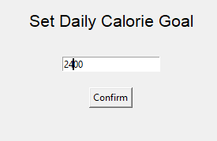
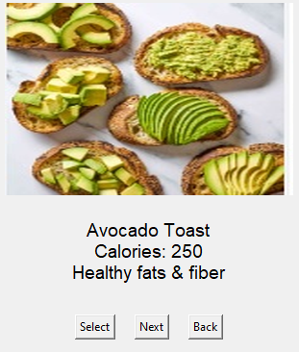
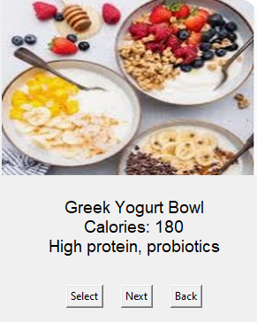
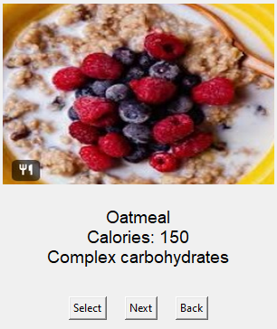
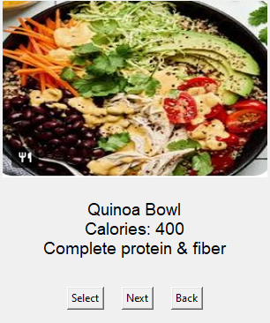
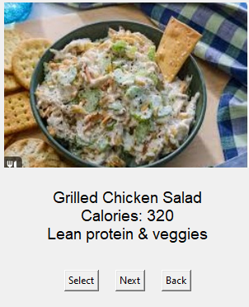
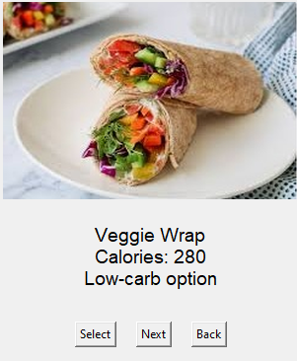
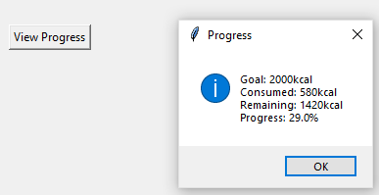
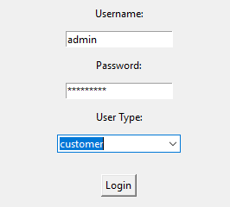
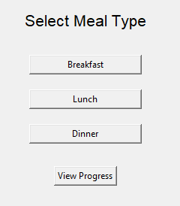
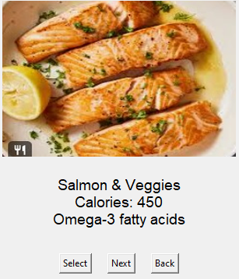
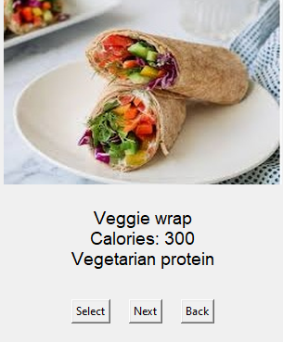
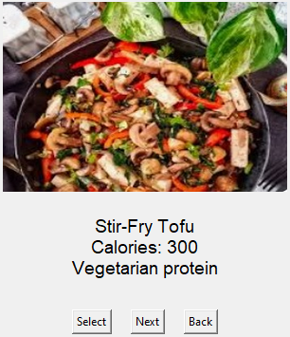

Slide 9
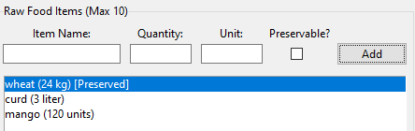
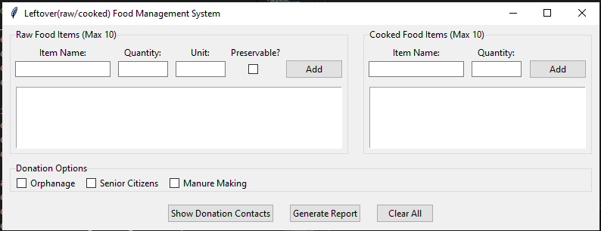
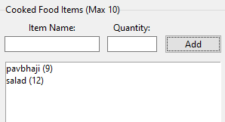
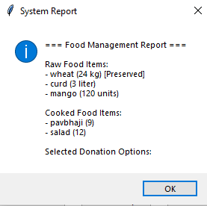
Leftover Management for Raw Edibles:

Slide 10
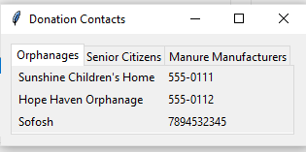
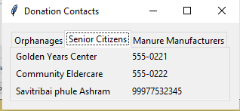
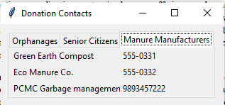
Leftover Management for Raw Edibles:
Help Others: Make the community better.
Help those who need it most.
Use Data: Check food waste trends.
Plan smarter orders next time.

Slide 11
Leftover Management for Raw Edibles:
Stop Waste: Use extra food to help people or recycle it.
Easy Start: Begin with 10 items. Grow as your business grows.
Help the Community: Support people in need through your business efforts.
Use Data: Track food waste patterns. Plan smarter orders next time.

Slide 12
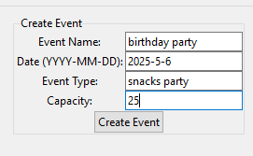
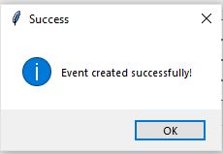
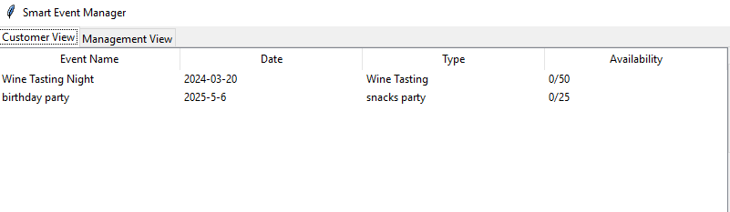
Event Management Module

Slide 13
Event Management Module
Focus on Customers: Create custom events. Keep guests happy and loyal.
Work Smarter: Use data to manage resources better.
Earn More: Offer upgrades (like special menus or decorations).
Stay Clear: Share instant updates and
improve communication.

Slide 14
Thank You

